Slide 1
Recurrence and Exploration of Out-of-Distribution Algorithms
Xiangyuan Xue
cooperating with Bangjun Wang

Slide 2
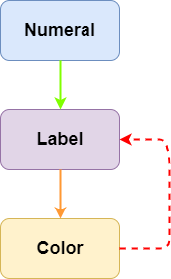
Invariant Risk Minimization
ERM
fail to catch causality
terrible performance on CMNIST
IRM
seek for invariant predictor
lower environmental difference

Slide 3
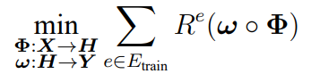
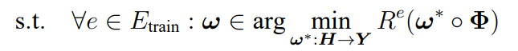

Mathematical Derivation
Target
optimal data representor $Φ$
optimal predictor $ω$
※ bi-level optimization, hard

Slide 4
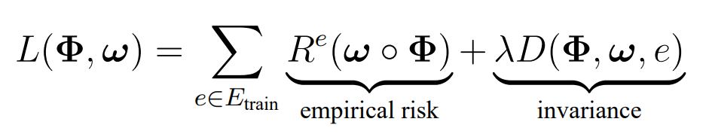

Mathematical Derivation
Constraints -> Penalty
※ $λ:$ penalty weight
Hypothesis: $Φ, ω$ are both linear

Slide 5

Mathematical Derivation
Single environment
Least square solution

Slide 6

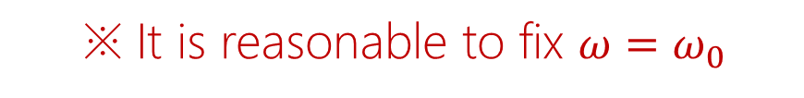
Mathematical Derivation
Transformation
Define distance
※ It is reasonable to fix $ω=ω_{0}$

Slide 7
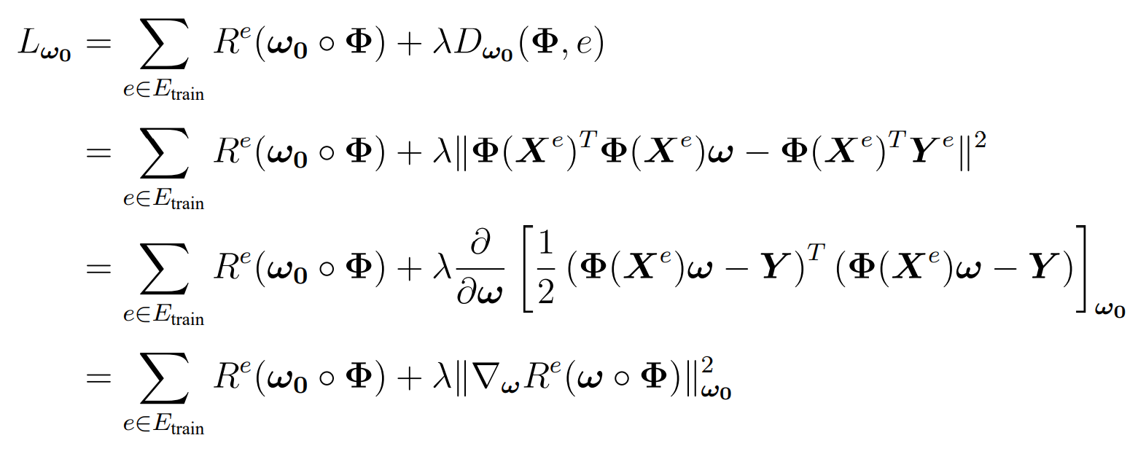
Mathematical Derivation
Loss function
※ Reuse first term, convenient

Slide 8
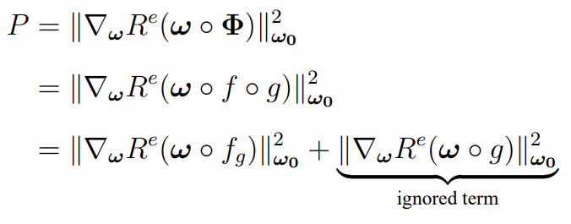


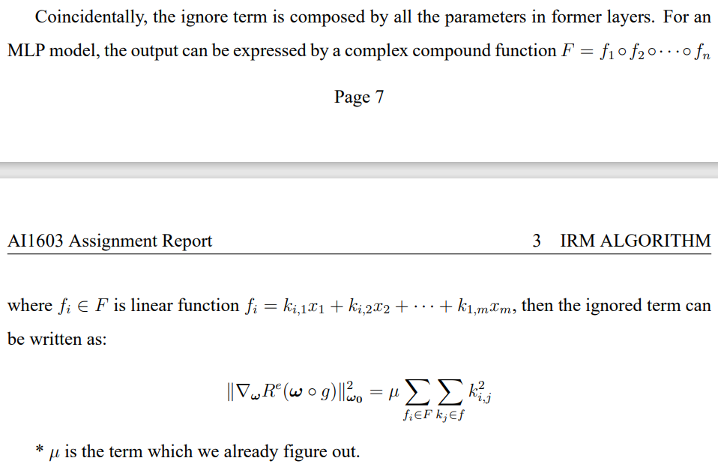
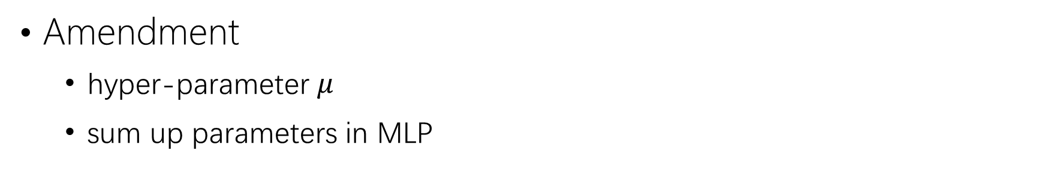

Significant Amendment
Ignored term for non-linear $Φ$
Amendment
hyper-parameter $μ$
sum up parameters in MLP

Slide 9
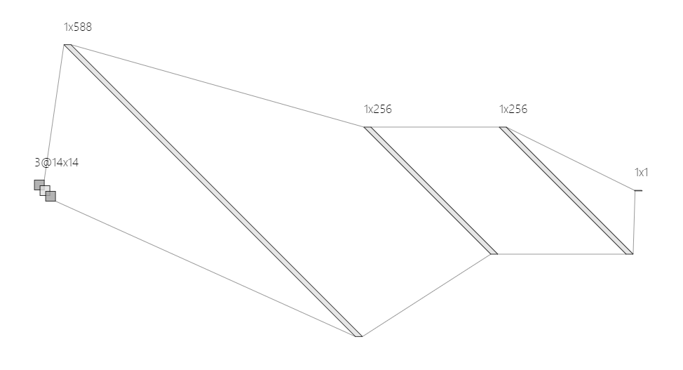
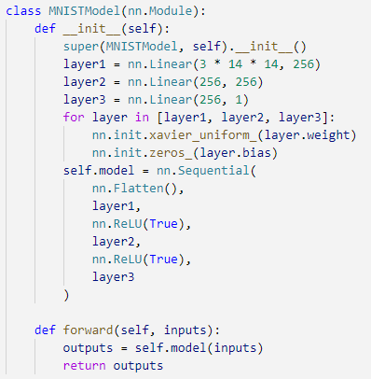
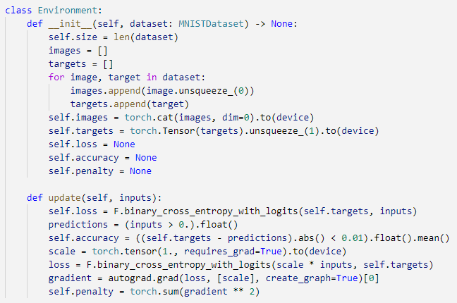
Algorithm Implementation

Slide 10
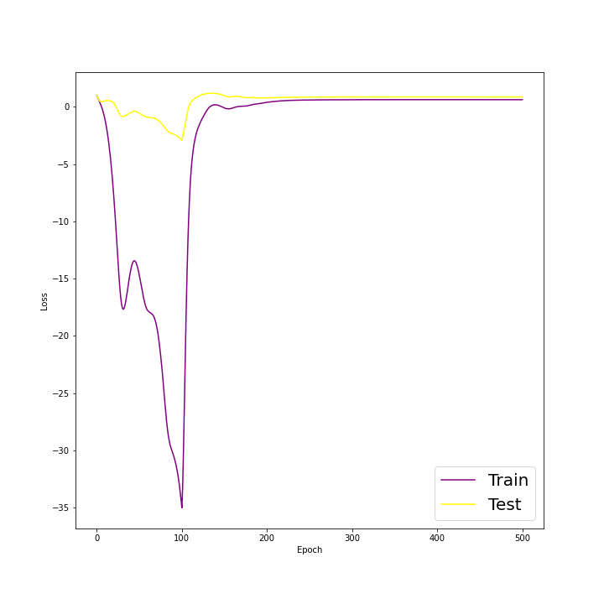
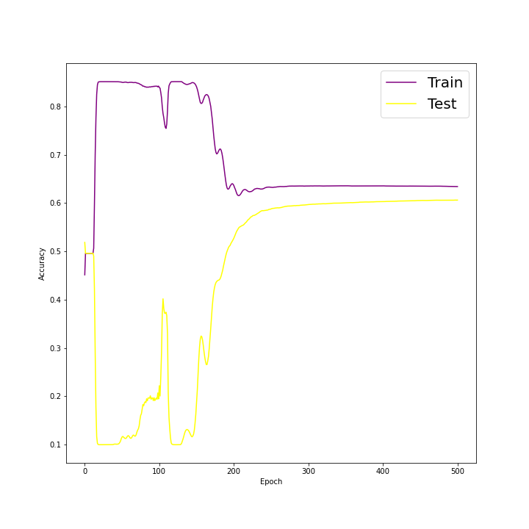
Algorithm Implementation
Recurrence performance
Loss - Epoch
Accuracy - Epoch

Slide 11
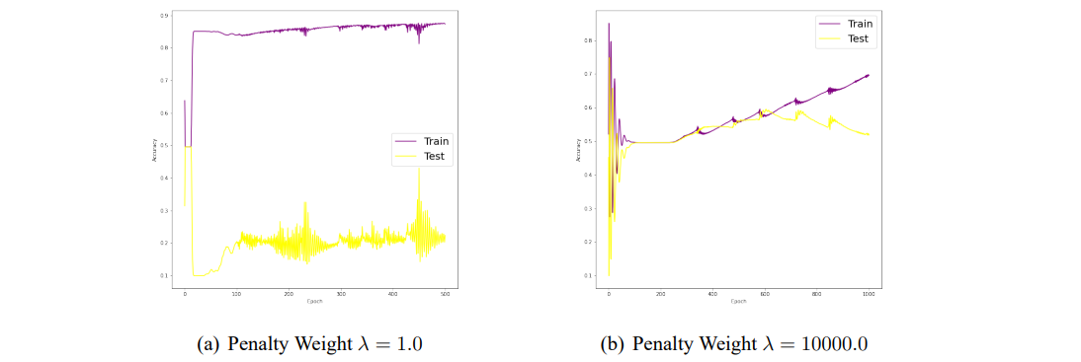
Sensitiveness to Penalty Weight
Figure: IRM learning curve with constant penalty weight

Slide 12
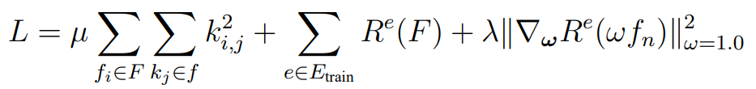
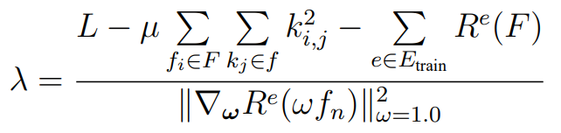
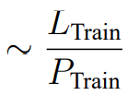
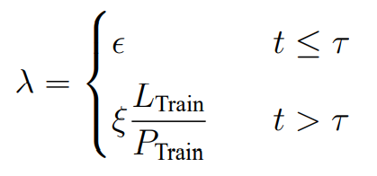
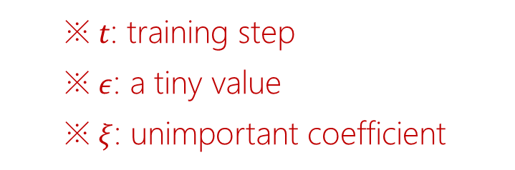
Self-Adaptive Optimization
Optimized penalty weight
※ $t$: training step
※ $ε$: a tiny value
※ $ξ$: unimportant coefficient

Slide 13
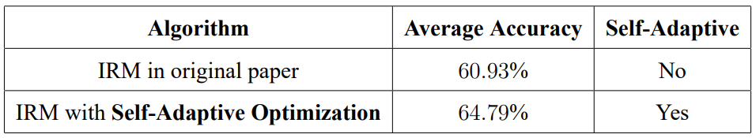
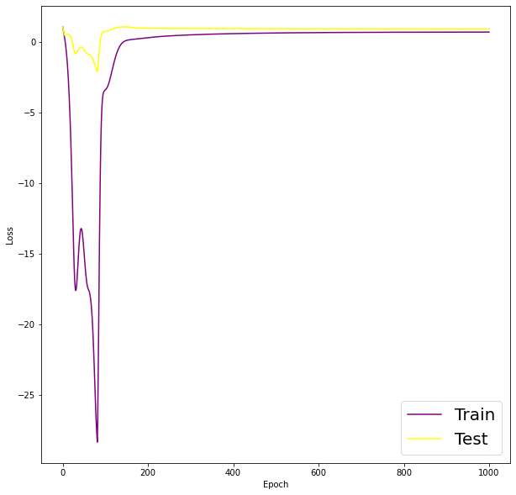
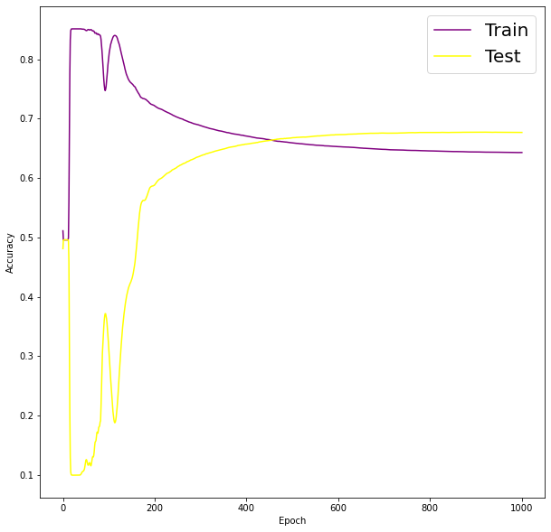
Self-Adaptive Optimization
Optimized performance
Loss - Epoch
Accuracy - Epoch

Slide 14
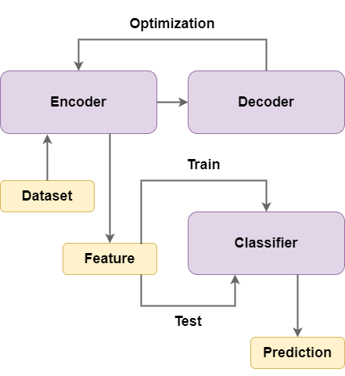
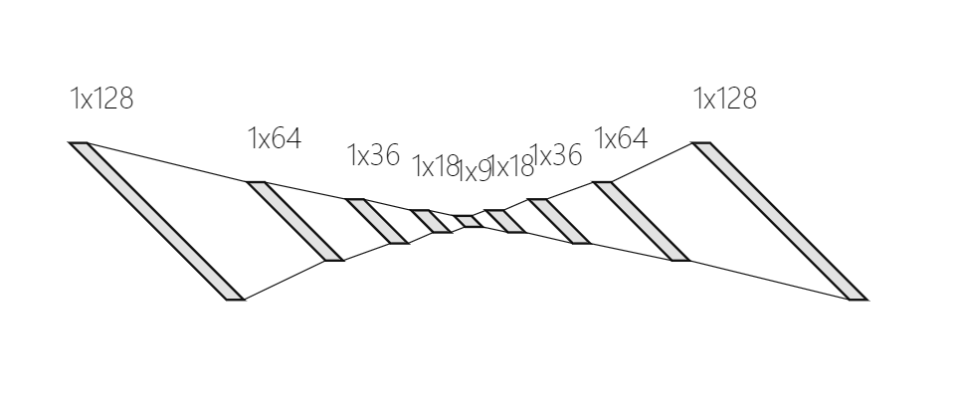

Algorithm Exploration
Unsupervised learning
feature extractor $ψ, φ$
classifier $θ$
※ Inspired by AutoEncoder

Slide 15

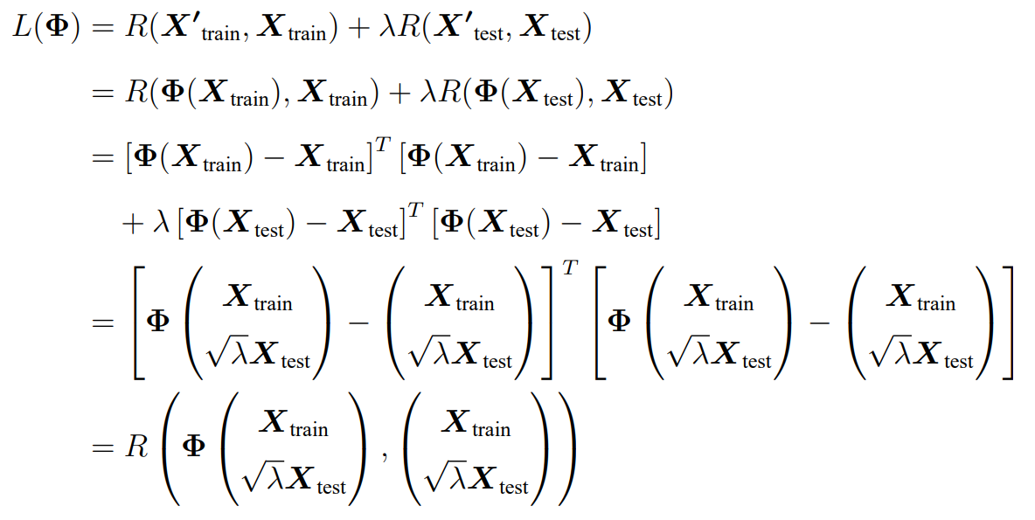
Algorithm Exploration
Convergence analysis

Slide 16
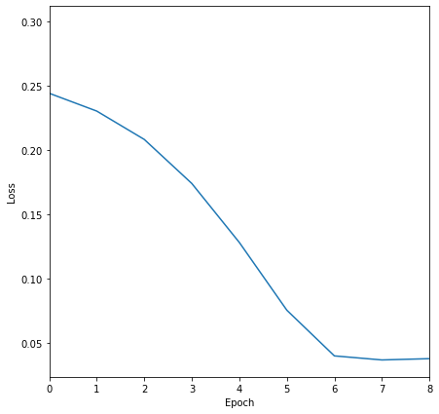
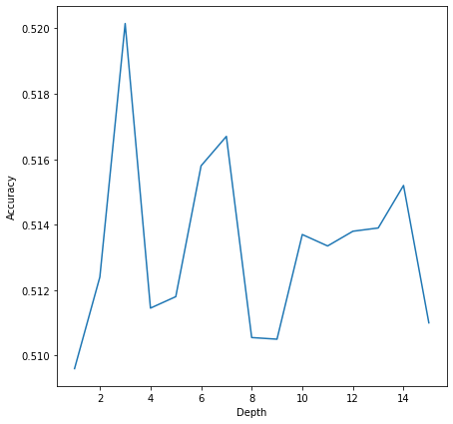
Algorithm Exploration
Experiment performance
Loss - Epoch
Accuracy - Depth

Slide 17
Conclusion
IRM
sort out derivation and replenish some details
solve several troubles and implement algorithm
propose self-adaptive optimization
Exploration
propose unsupervised feature extractor
analyze convergence of model
apply to experiment

Slide 18
References
Martin Arjovsky, Léon Bottou, Ishaan Gulrajani, and David Lopez-Paz. Invariant Risk Minimization. arXiv:1907.02893, 2019.
Elan Rosenfeld, Pradeep Ravikumar, and Andrej Risteski. The Risks of Invariant Risk Minimization. arXiv:2010.05761, 2020.
Yaroslav Ganin, Evgeniya Ustinova, Hana Ajakan, Pascal Germain, Hugo Larochelle, François Laviolette, Mario Marchand, and Victor Lempitsky. Domain-Adversarial Training of Neural Networks. arXiv:1505.07818, 2015.
Puwei Dai. Explanation of DANN and GRL. https://zhuanlan.zhihu.com/p/109051269, 2021.
Yearn. Invariant Risk Minimization Reading Notes. https://zhuanlan.zhihu.com/p/273209891, 2022.
Martin Arjovsky et al. Code Repository for Invariant Risk Minimization. https://github.com/facebookresearch/InvariantRiskMinimization, 2020.

